Slide 1
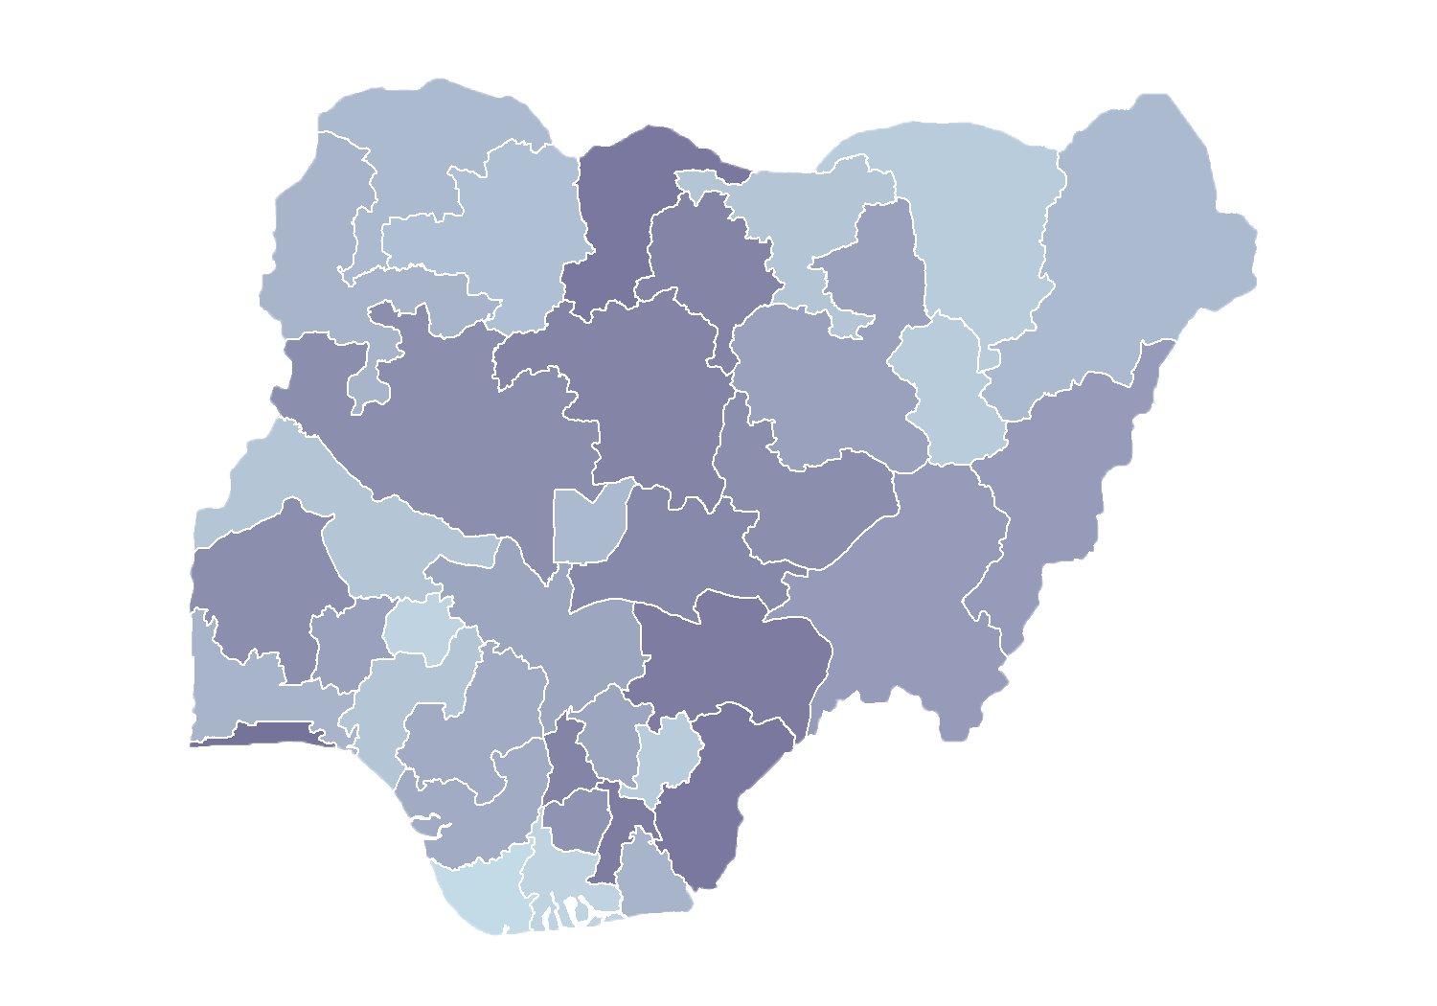
Module 1.1
Review Action Plan
Rollout of Health Facility Registry/Master Facility List for States and Local Government Areas in Nigeria
June 2019

Slide 2
Outline
Add new facilities
Delete nonexistent facilities
Facility visits
Completed forms
Quality of forms

Slide 3
Add new facilities
from LGA-maintained list
# | Description
1 | Facilities in the Master Facility List (MFL)
2 | Facilities in local government area (LGA) list
3=(1-2) | Difference between MFL and LGA lists
4 | Facilities to be added to MFL from LGA
Comment: Certain facilities on the LGA list need to be discarded, because they are duplicates.

Slide 4
Add new facilities
from DHIS 2-maintained list
# | Description
5 | Facilities in the MFL
6 | Facilities in DHIS 2 list
7=(5-6) | Difference between MFL & DHIS 2 lists
8 | Facilities to be added to MFL from DHIS 2
Comment: Certain facilities on the DHIS 2 list need to be discarded, because they are duplicates.

Slide 5
Delete nonexistent facilities
% of deletions documented
# | Description
9 | Facilities in the MFL
10 | Facilities to be deleted*
11=(9-10) | Number of facilities remaining after deletion
Comment: Facilities to be deleted either are duplicates or never existed.

Slide 6
Total number of facilities
remaining on MFL
# | Description
12=(4+8+11) | Total number of facilities on MFL
Total number of facilities: All facilities including those to be added, with duplicate facilities removed

Slide 7
Facility visits
Proportion of completed visits
# | Description
13 | Facilities requiring visit – to complete missing information from MFL
14 | Facilities requiring visit – added from LGA list
15 | Facilities requiring visit – added from DHIS 2 list
16=(13+14+15) | Facilities requiring visit - total
17 | Facilities visited
18=(17/16) | Proportion of completed visits
Facilities to be visited: These either are missing coordinates or have wrong coordinates.

Slide 8
Completed forms
Deleted facilities
# | Description
19 | Facilities to be deleted*
20 | Verified forms for deleted facilities
21=(20/19) | % of deletions documented
Facilities to be deleted: Deletions documented

Slide 9
Completed forms
Facilities to add or update
# | Description
22 | Facilities to be added or updated
23 | Verified forms for addition or update
24=(23/22) | % of additions or updates documented
Facilities to add or update: Updates or additions documented

Slide 10
Quality of forms
% of complete forms
# | Description
25 | Forms with updated information or new facilities
26 | Forms with filled coordinates
27 | Forms with 90% of fields completed
28 | Forms with both filled coordinates and 90% of fields
29=(28/25) | % of complete forms

Slide 11
Next steps
Over the course of the 3-day training, will you be able to improve any of the following?
% of deletions documented
% of updates or additions documented
% of complete forms

